Slide 1
REST : Representation State Transfer

Slide 2
Examples - REST
Twitter API
Google Maps
Twillio
Github
Foursquare
blogger.com
REST is an “Architectural Style” - enumerating an approach to building distributed systems.
It embodies an approach that aims to maximize the infrastructure of http infrastructure deployed in the public internet, enabling secure, scalable distributed systems that do not require expensive, complex alternative infrastructure.

Slide 3

REST
Representational State Transfer (REST) is an architectural style that abstracts the architectural elements within a distributed hypermedia system.[1] REST ignores the details of component implementation and protocol syntax in order to focus on the roles of components, the constraints upon their interaction with other components, and their interpretation of significant data elements.[2]REST has emerged as a predominant web API design model

Slide 4
REST: The Web Used Correctly
A system or application architecture
... that uses HTTP, URI and other Web standards “correctly”
... is “on” the Web, not tunnelled through it ... also called ““RESTful HTTP”

Slide 5
Rest Principles
1: Give Everything and ID
2: Link Things Together
3: Use Standard HTTP Methods
4: Allow for Multiple Representations
5: Communicate Statelessly

Slide 6
1: Give Every Thing and ID
http://example.com/customers/1234
http://example.com/orders/2007/10/776654
http://example.com/products/4554
http://example.com/processes/sal-increase-234

Slide 7
2: Link Things Together
<order self=’http://example.com/orders/1234’>
<amount>23</amount>
<product ref=’http://example.com/products/4554’ />
<customer ref=’http://example.com/customers/1234’ />
</order>

Slide 8
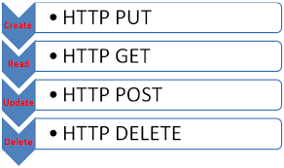
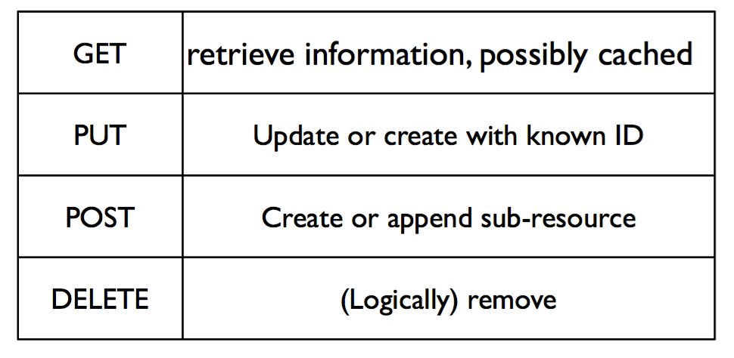
3: Use Standard HTTP Methods

Slide 9


4: Allow for Multiple Representations
GET /donors/1234
Host: example.com
Accept: application/json
{
"firstName" : "fred",
"lastName" : "simpson",
"email" : "fred@simpson.com",
"password" : "secret"
}
GET /donors/1234
Host: example.com
Accept: application/xml
<donor>
<firstName> “fred” </firstName>
<lastName> “simpson” </lastName>
<email> “fred@simpson.com” </email>
<password> “secret” </password>
</donor>

Slide 10
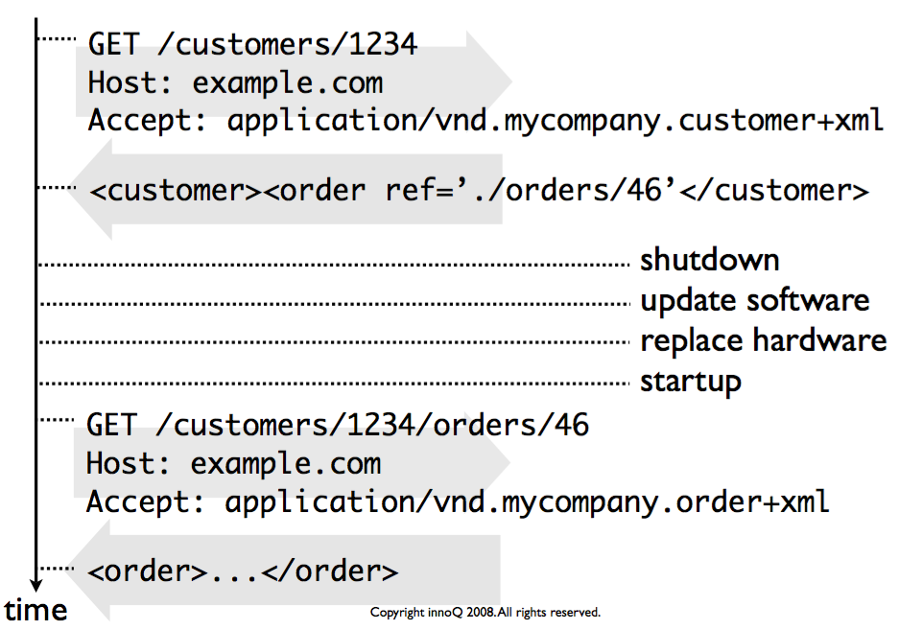
5: Communicate Statelessly

Slide 11
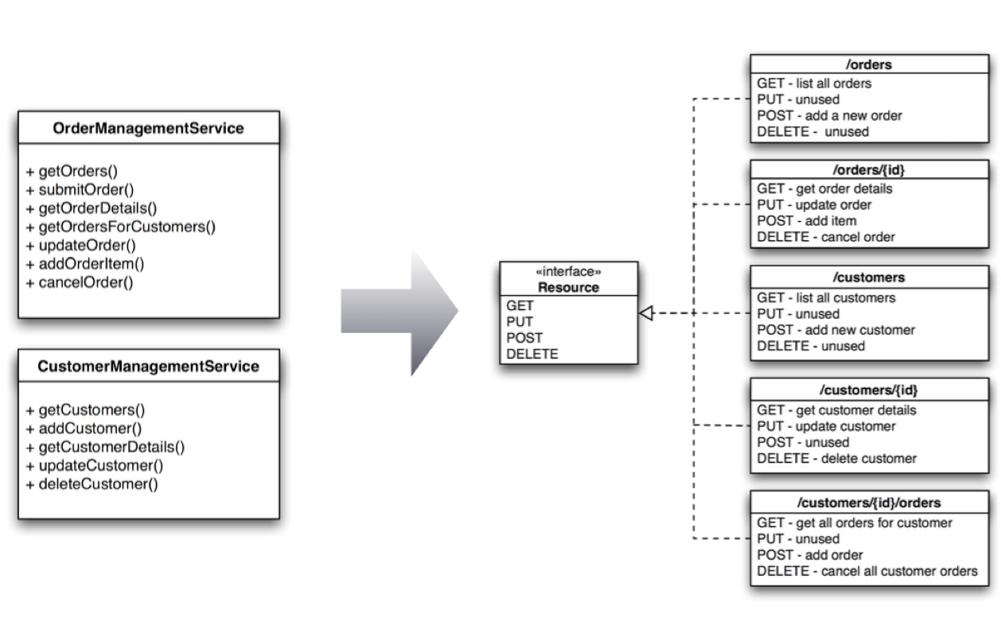

Slide 12
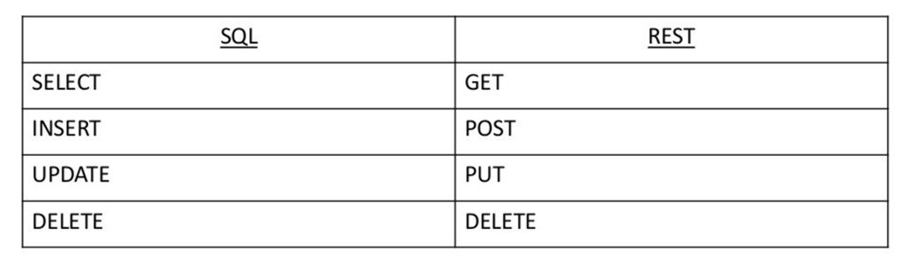
Rest Endpoints Verbs
Comparing database (sql) and HTTP Verbs

Slide 13
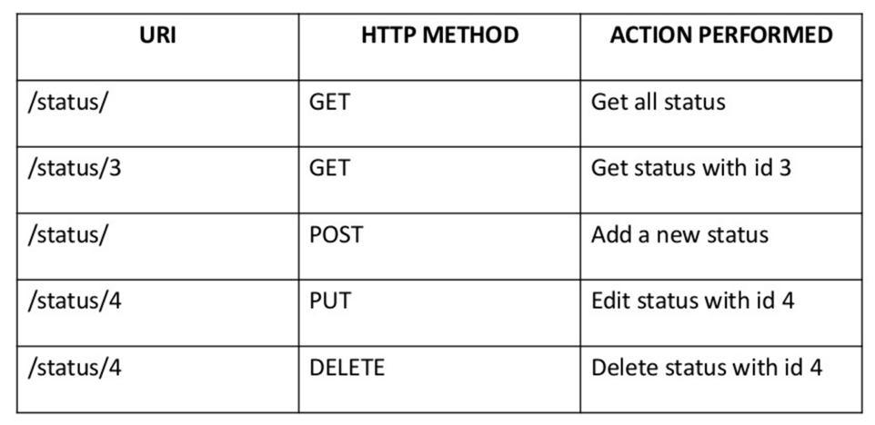
Action varies with HTTP Method

Slide 14
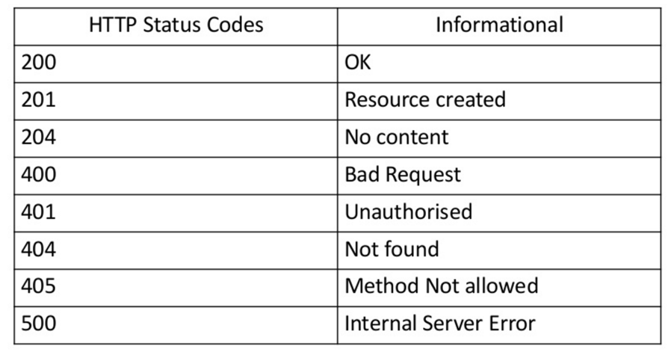
HTTP Response Codes

